Slide 1

PROJECT TITTLE
SMART CONTROL OF TRAFFIC LIGHTS BY USING ARTIFICIAL INTELLIGENCE
Submitted by
SYED ISMAIL
(Reg no:230200046201)
Under the guidance of
Mr.Dr.B.Gopi Krishna Varma (M.C.A, Ph.D.) professor
DEPARTMENT OF COMPUTER APPLICATIONS
KRISHNA CHAITANYA INSTITUTE OF SCIENCE & TECHNOLOGY
(Affiliated to V.S University,kakutur, Nellore(A.P)

Slide 2
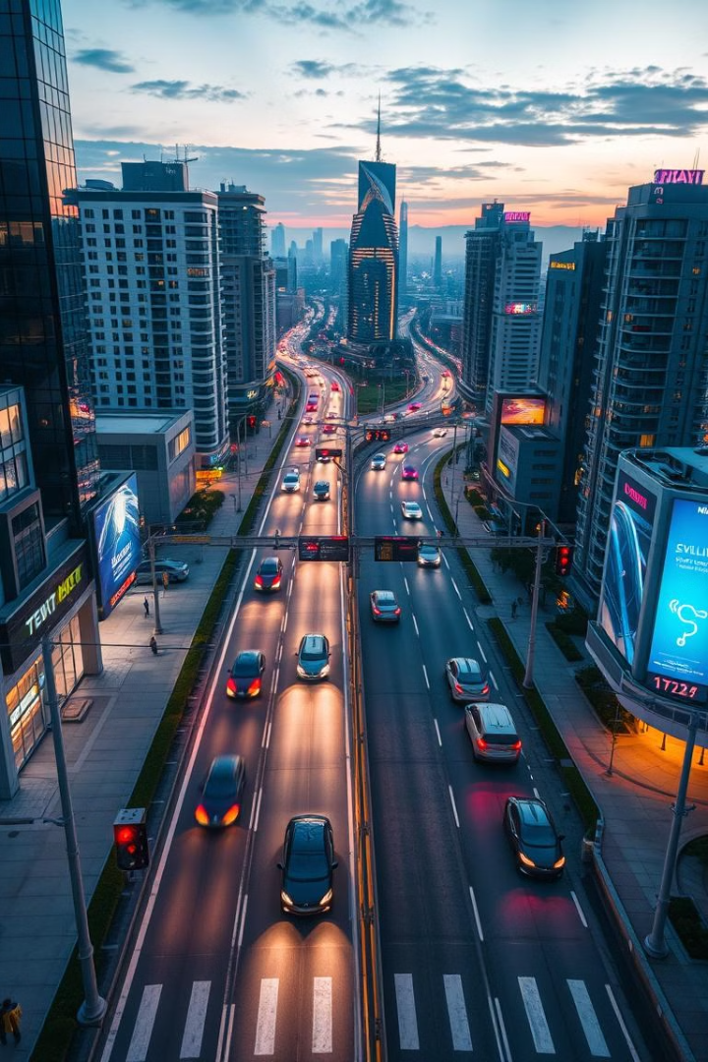
INTRODUCTION:
Smart control of traffic lights by using artificial intelligence using python
This presentation introduces AI-powered traffic management using Python. We'll explore leveraging Python for efficient and adaptive traffic control. Our goal is to address urban congestion with intelligent infrastructure.

Slide 3
The Problem: Inefficient Traffic Management
Traditional Systems
Congestion Factors
Wasted Resources
Traditional fixed-time traffic light systems are inefficient. They do not adapt to changing traffic conditions.
Urban traffic congestion is caused by population density and accidents.
The average US driver spends 54 hours in traffic annually. This costs $1,010 in wasted fuel (INRIX 2023).

Slide 4
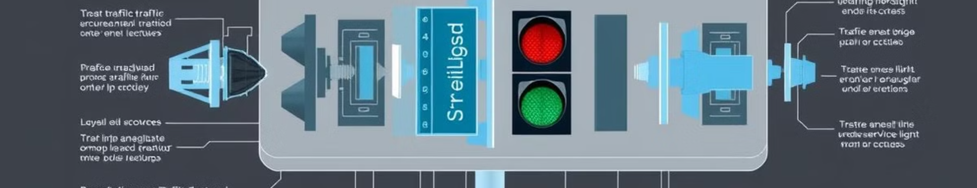
Components
1
Hardware
2
Software
3
Communication
Traffic Light Controllers
Real-Time Operating Systems.
Wireless Communication Modules.

Slide 5




AI-Powered Solution: Adaptive Traffic Control
Real-time Data
Collect data using sensors and cameras.
AI Algorithms
Use AI (Reinforcement Learning, Neural Networks) to predict traffic flow.
Dynamic Adjustment
Adjust traffic light timings based on current conditions.
Pittsburgh's SURTRAC system reduced travel times by 25% and emissions by 20%.

Slide 6



Implementing with Python: Key Libraries
OpenCV
TensorFlow/Keras
SUMO
Real-time video processing and object detection.
Building and training AI models.
Simulating traffic scenarios for algorithm testing.

Slide 7
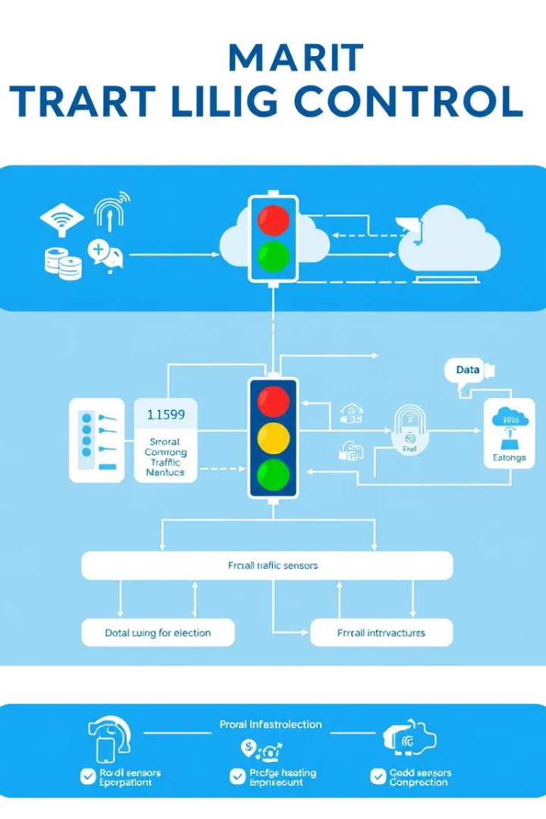
System Architecture: Data Flow
1
Sensor Network
Cameras, loop detectors, GPS data from connected vehicles.
2
Data Preprocessing
Cleaning and formatting sensor data.
3
AI Engine
Real-time traffic prediction. Optimal timing calculation.
4
Actuation
Sending commands to traffic light controllers.

Slide 8
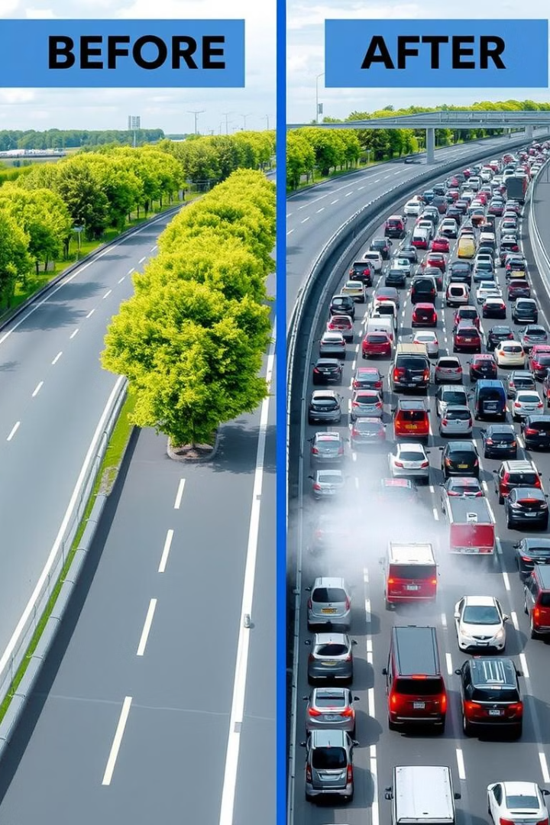
Benefits of Smart Traffic Light Control
Reduced Congestion
Up to 40% reduction in travel times.
Improved Air Quality
Up to 25% reduction in vehicle emissions.
Enhanced Safety
Reduced accidents through optimized flow.
Increased Efficiency
Better utilization of infrastructure.

Slide 9
Case Studies and Real-World Examples
Singapore
London
Spain
Reduced peak hour travel times by 15%.
SCOOT system: 12% reduction in delays.
50% less waiting time at signals.
These examples demonstrate improved traffic metrics through smart traffic management.

Slide 10




Future Trends and Opportunities
Autonomous Vehicles
1
Predictive Maintenance
2
4
Expanded Networks
3
Pedestrian Safety
Integrating IoT devices and predictive maintenance offers possibilities.

Slide 11
Conclusion:
Efficient Traffic Management: AI-based control dynamically adjusts signals, reducing congestion and wait times. Real-Time Adaptability: Uses live data to optimize traffic flow based on current conditions.
Python & AI Integration: Leverages libraries like OpenCV, TensorFlow, and NumPy for automation and intelligent decision-making. Improved Urban Mobility: Enhances road efficiency, reduces emissions, and supports smart city development.
Future Enhancements: IoT integration, reinforcement learning, and vehicle-to-infrastructure (V2I) communication for further improvements.

